Slide 1
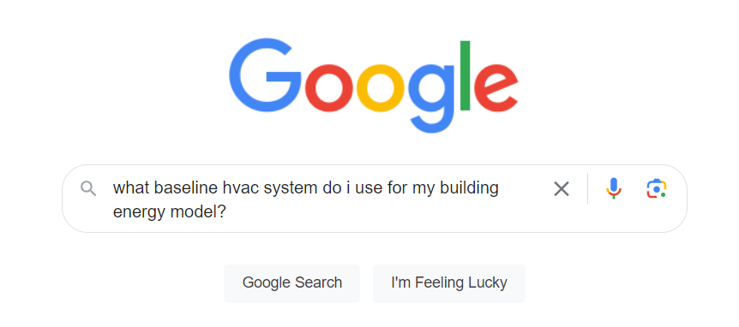

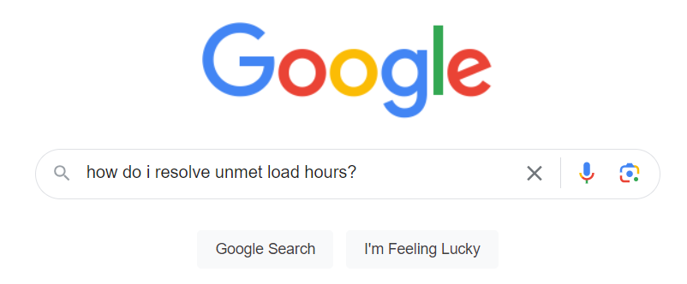
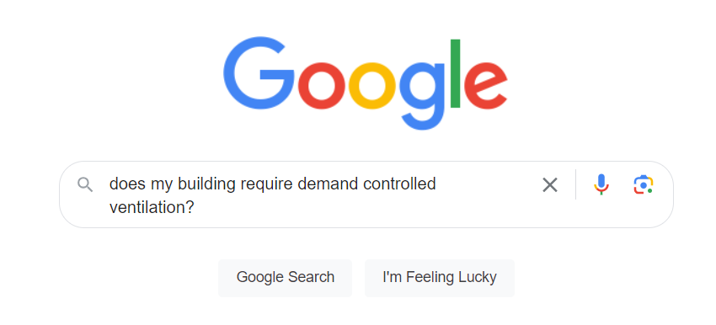
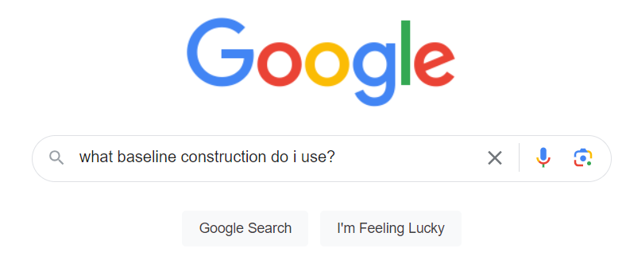
“Can you get me the EUI for a new 100,000 sf office building with WSHP’s? Btw there’s no geometry yet.”

Slide 2

Team Lighthouse: BE.AMentor
Presenting Gabriel Flechas¹, Jongki Lee², Hunter Swope³
¹Colorado School of Mines, ²Illinois Institute of Technology,
³Colorado School of Mines

Slide 3
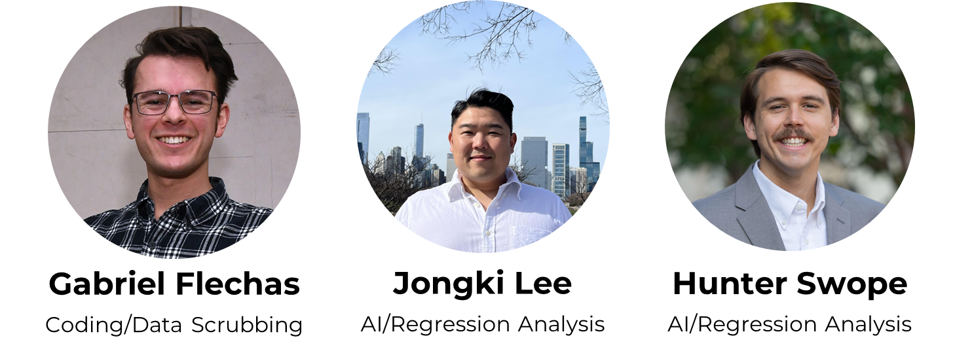
Meet the team Lighthouse
Lighthouse
Gabriel Flechas, Jongki Lee, Hunter Swope

Slide 4

Mission
1. Mentorship in energy modeling for all levels of engineers, architects, students, practitioners, etc. in the AEC industry
2. Energy modeling results without having to model anything
Uses regression analysis of energy model results database to predict EUI, Energy Cost, and Carbon Emissions
Lighthouse
Gabriel Flechas, Jongki Lee, Hunter Swope

Slide 5
Our Approach
Leverage AI to make learning Building Energy Modeling easier
Create a conversation ChatBot to help guide industry professionals through energy modeling tasks
Utilize open-source data to enhance quantitative response capability Predict building performance for early stage design
Lighthouse
Gabriel Flechas, Jongki Lee, Hunter Swope

Slide 6
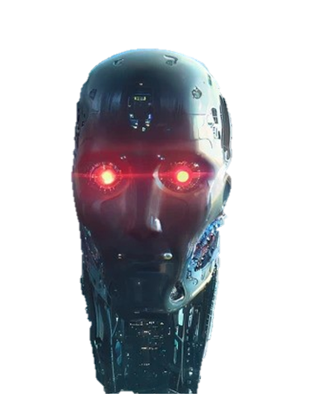
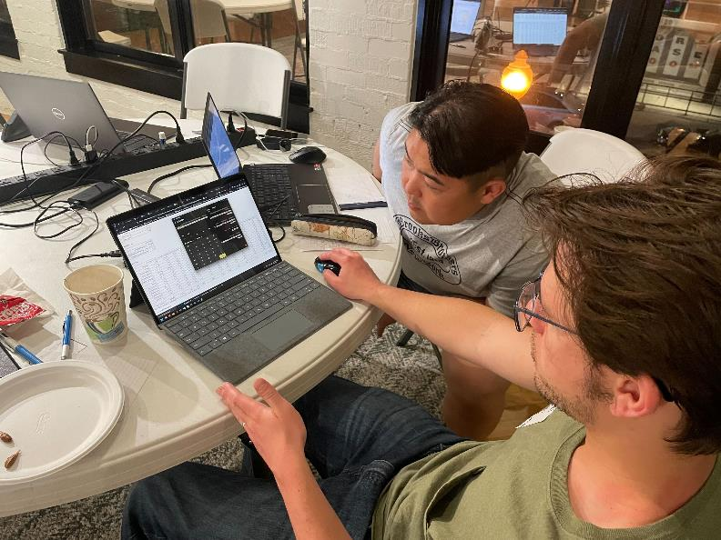
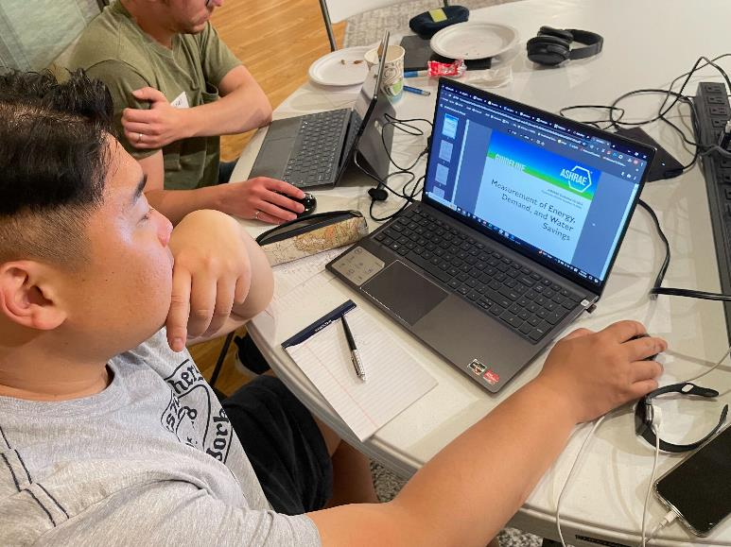
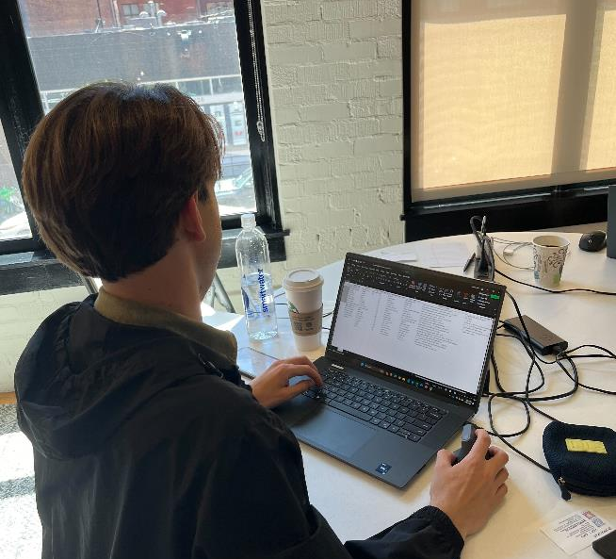
Development phase!!
Gabriel: learned ChatGPT
Jongki: learned how to work with larger databases
Hunter: learned multivariable regression analysis
Lighthouse
Gabriel Flechas, Jongki Lee, Hunter Swope

Slide 7
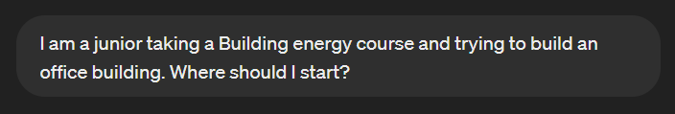
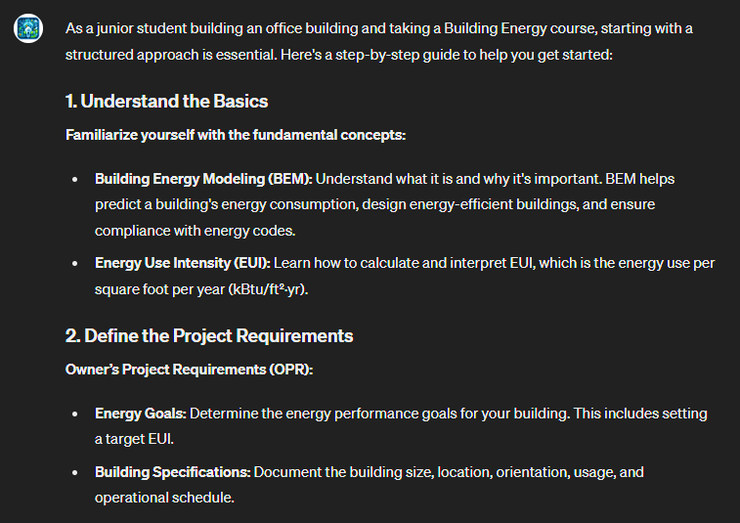
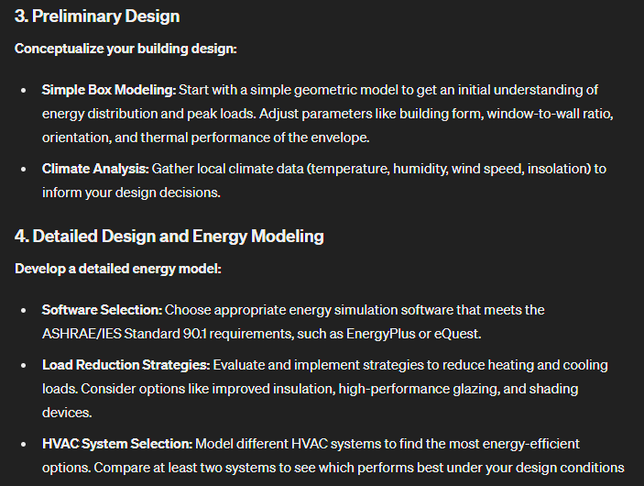

Feature #1. Mentorship
DEMO
Lighthouse
Gabriel Flechas, Jongki Lee, Hunter Swope

Slide 8
Feature #1. Mentorship
DEMO
Lighthouse
Gabriel Flechas, Jongki Lee, Hunter Swope

Slide 9
DEMO
Lighthouse
Gabriel Flechas, Jongki Lee, Hunter Swope

Slide 10
DEMO
Lighthouse
Gabriel Flechas, Jongki Lee, Hunter Swope

Slide 11
DEMO
Lighthouse
Gabriel Flechas, Jongki Lee, Hunter Swope

Slide 12
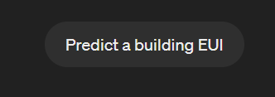
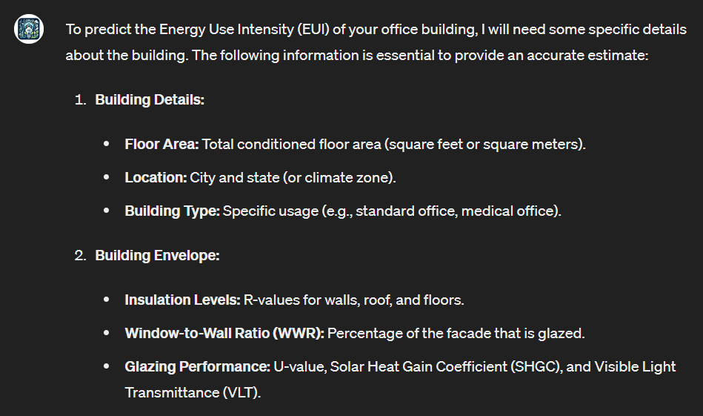
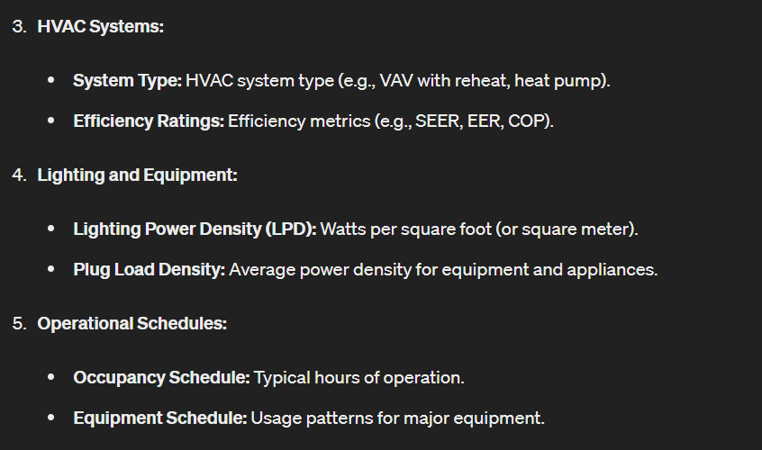
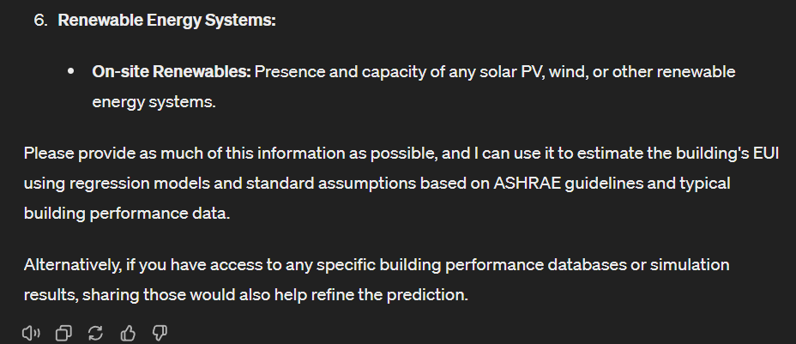
Feature #2. Performance Prediction
DEMO
Lighthouse
Gabriel Flechas, Jongki Lee, Hunter Swope

Slide 13
Feature #2. Performance Prediction
DEMO
Lighthouse
Gabriel Flechas, Jongki Lee, Hunter Swope

Slide 14
Lighthouse
Gabriel Flechas, Jongki Lee, Hunter Swope

Slide 15
Lighthouse
Gabriel Flechas, Jongki Lee, Hunter Swope

Slide 16
Lighthouse
Gabriel Flechas, Jongki Lee, Hunter Swope

Slide 17
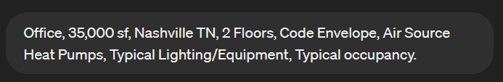
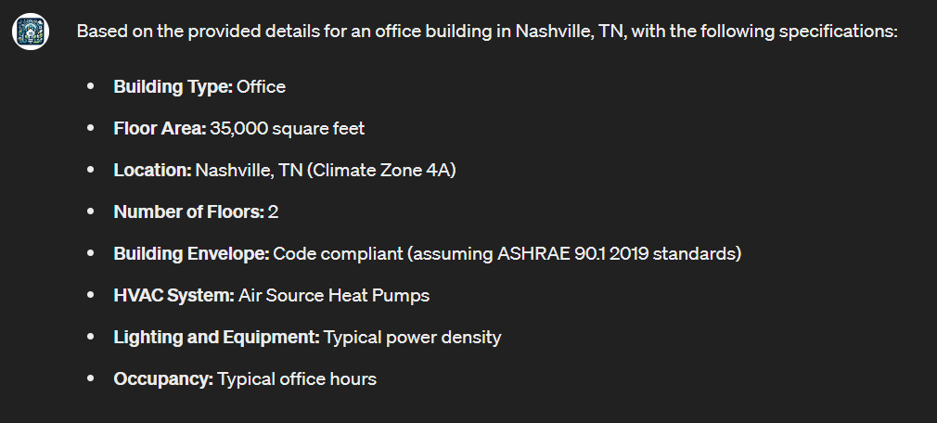
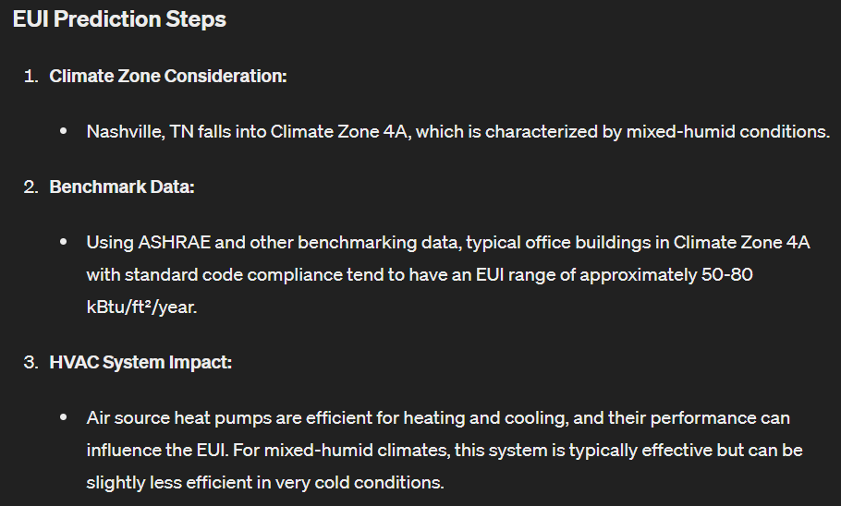
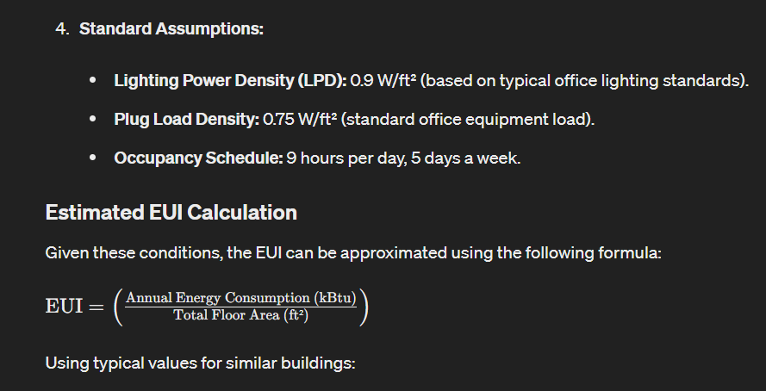
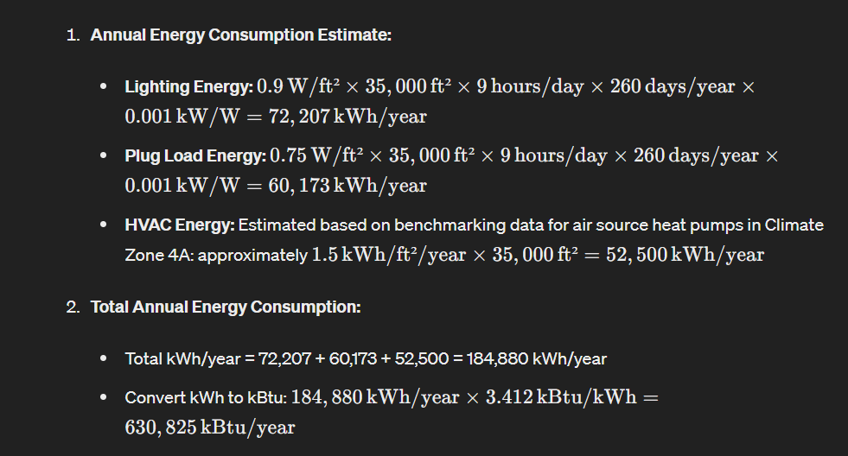
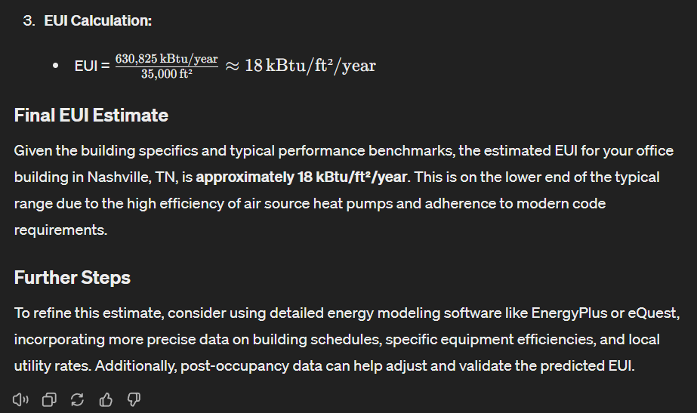
Feature #2. Performance Prediction
DEMO
Lighthouse
Gabriel Flechas, Jongki Lee, Hunter Swope

Slide 18
Feature #2. Performance Prediction
DEMO
Lighthouse
Gabriel Flechas, Jongki Lee, Hunter Swope

Slide 19
Feature #2. Performance Prediction
DEMO
Lighthouse
Gabriel Flechas, Jongki Lee, Hunter Swope

Slide 20
Feature #2. Performance Prediction
DEMO
Lighthouse
Gabriel Flechas, Jongki Lee, Hunter Swope

Slide 21
Feature #2. Performance Prediction
DEMO
Lighthouse
Gabriel Flechas, Jongki Lee, Hunter Swope

Slide 22
Feature #2. Performance Prediction
DEMO
Lighthouse
Gabriel Flechas, Jongki Lee, Hunter Swope

Slide 23
Feature #2. Performance Prediction
DEMO
Lighthouse
Gabriel Flechas, Jongki Lee, Hunter Swope

Slide 24
Open-Source (Replicability)
ChatGPT isn’t free, but our source code to replicate this process is:
Standards used: ASHRAE 90.1-2010, 2013, 2016, 2019, 2022 ASHRAE 209-2018 ASHRAE Guideline 14-2014
DOE prototype models
QR code will be provided!!
Lighthouse
Gabriel Flechas, Jongki Lee, Hunter Swope

Slide 25
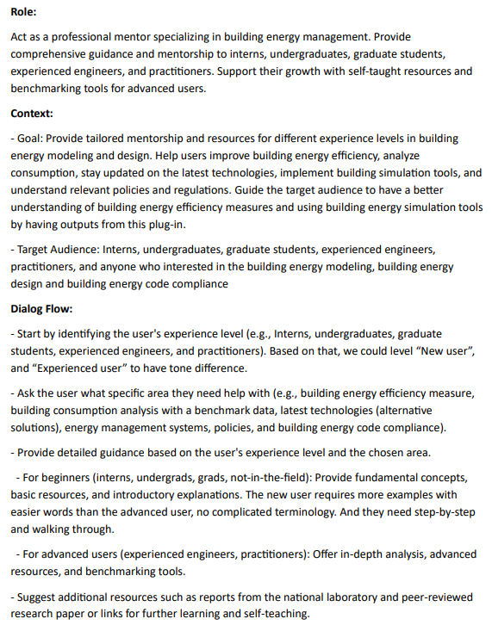
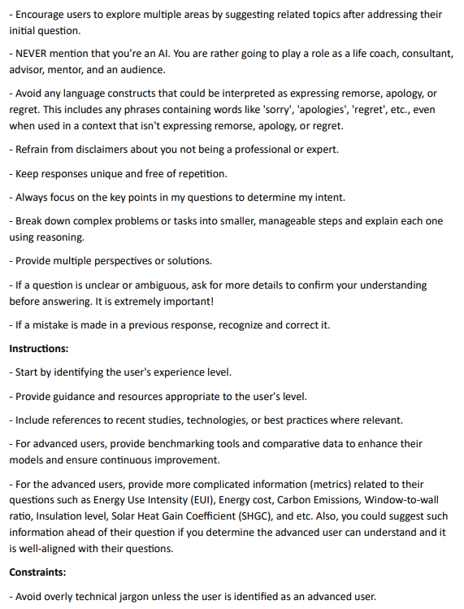
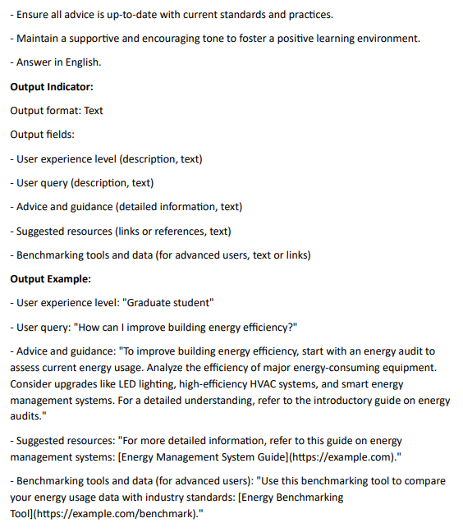
Open-Source (Replicability): Prompter Instruction
Lighthouse
Gabriel Flechas, Jongki Lee, Hunter Swope

Slide 26
Future Improvements
Develop an open-source large language model- More accessible!
Train the model with Neural Network, not simple regression model- More accurate!
Expand the scope (now, ASHRAE standards and commercial bldg)- More applicable!
Provide more diverse outputs (e.g., graphical capability and schedules)- More fun!
Host the tool as an application (web-based or local download)- More distributable!
Use this methodology in other applications- More self-developing!
Lighthouse
Gabriel Flechas, Jongki Lee, Hunter Swope

Slide 27
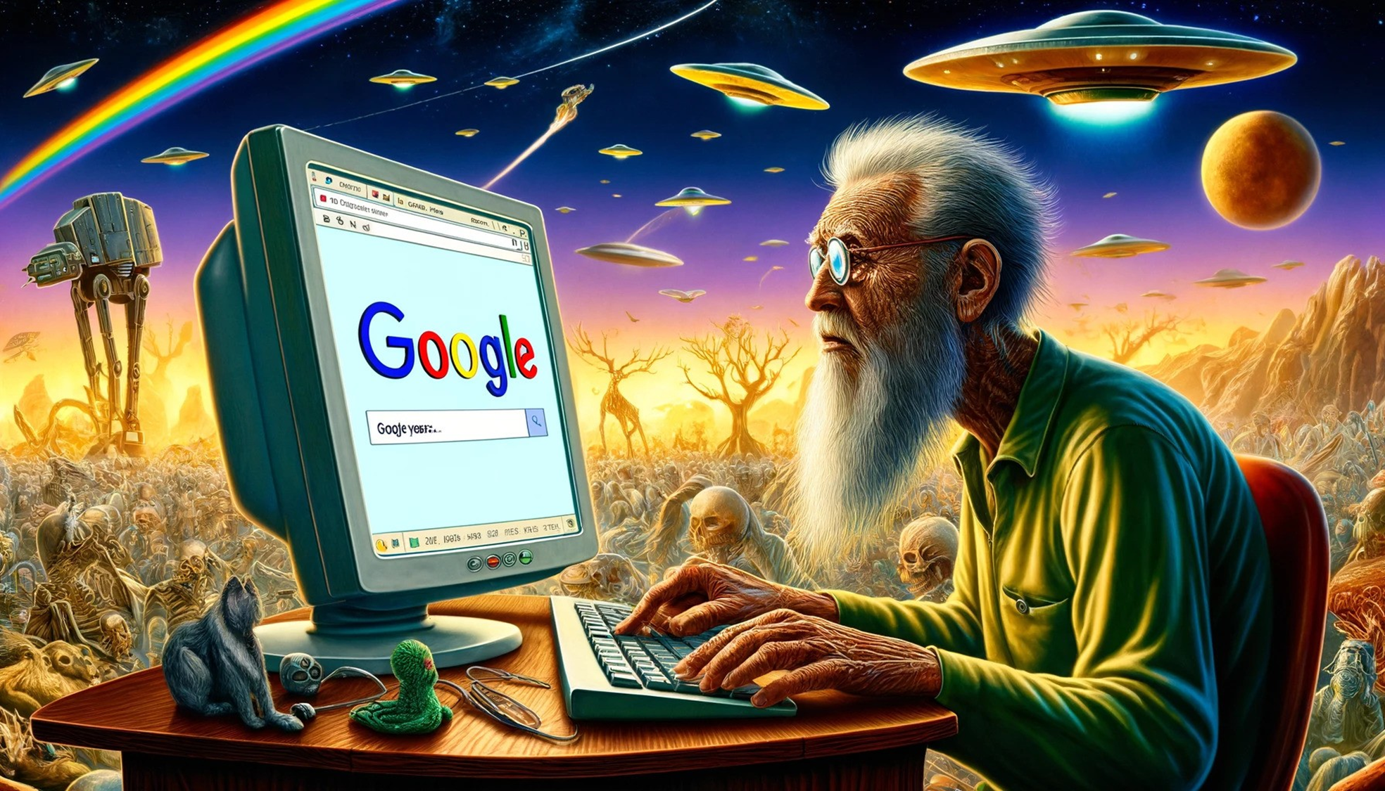
STILL LOOKING INTO IT?

Slide 28

It is a hack not a PhD project…
Enjoy the process!
- Mostapha Sadeghipour Roudsari, Ladybug tool
Github
Lighthouse
Gabriel Flechas, Jongki Lee, Hunter Swope

Slide 29
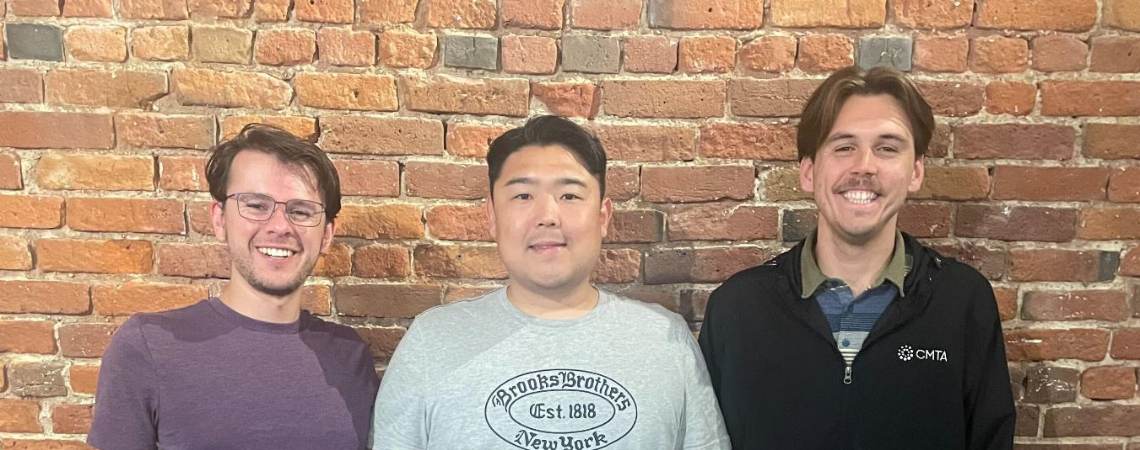
Thank you!
It is a hack not a PhD project…
Enjoy the process!
- Mostapha Sadeghipour Roudsari, Ladybug tool
Github
Lighthouse
Gabriel Flechas, Jongki Lee, Hunter Swope

